Slide 1
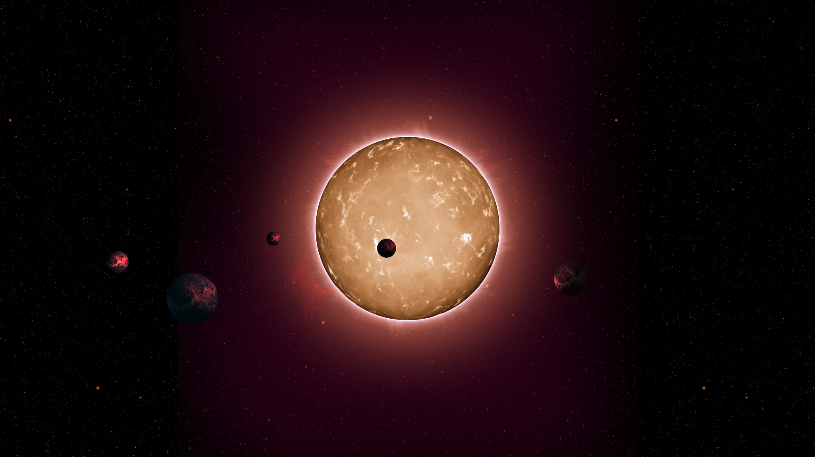
Exoplanet Detection
HUNT FOR THE HABITABLE
USING MACHINE LEARNING
Chhavi Gupta(102103322)
Angel(102103328)

Slide 2
This project aims to use Machine Learning Techniques to predict Exoplanets using Transit Method
Transit Method
A Digital-camera-like technology is used to detect and measure tiny intensity dips in a star’s brightness as a planet crosses in front of the star. With observations of transiting planets, astronomers can calculate the ratio of a planet’s radius to that of its star — essentially the size of the planet’s shadow — and with that ratio, they can calculate the planet’s size.

Slide 3
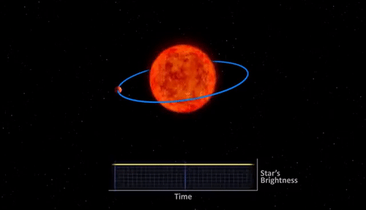
Transit Method
In the demonstration, a star is orbited by a planet. From the graph, it is visible that the starlight intensity drops because it is partially obscured by the planet, given our position. The starlight rises back to its original value once the planets crosses in front of the star.

Slide 4
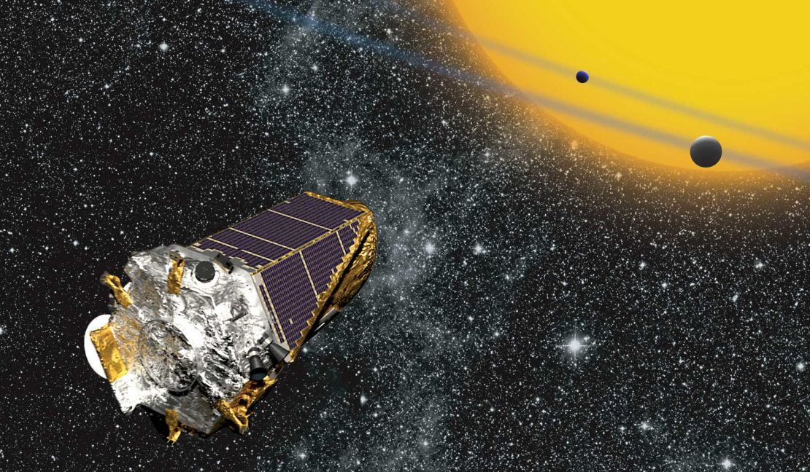
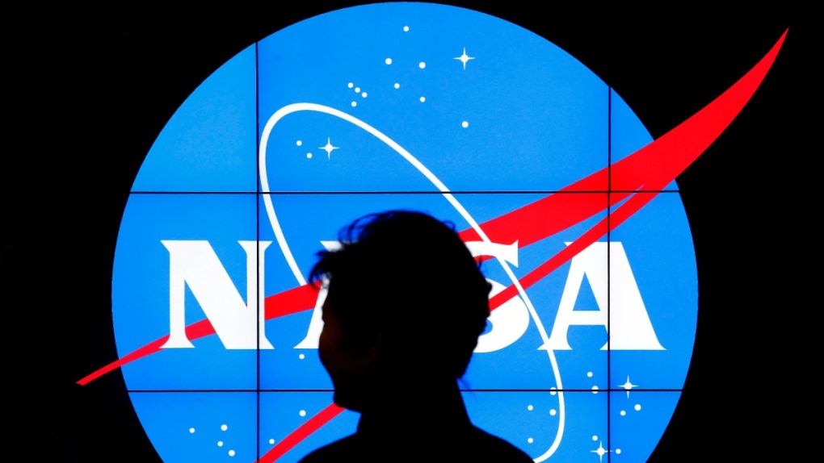
Acquiring The Dataset
The data is fetched from publicly available NASA’s API
Dataset is based on Kepler Space Mission starlight intensity time series data.
It contains data of 5087 potential exoplanet systems it has taken observations on.

Slide 5
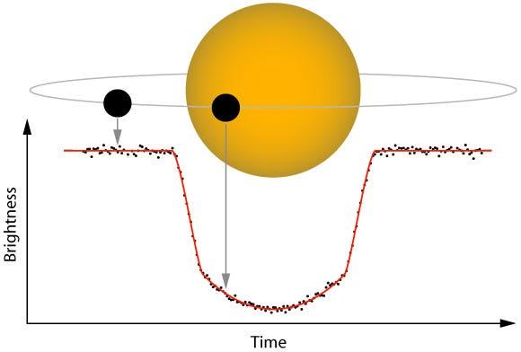
The goal is to create a model that can predict the existence of an Exoplanet, utilizing the flux (light intensity) readings from 3198 different stars over time.

Slide 6
DATA PREPROCESSING STEPS
Label Encoding of target variable to convert it into binary values.
PCA (Principal Component Analysis) to reduce the ‘curse of dimensionality’ in such dataset with a large number of features.(5087 rows & 3198 columns)
Data Normalization to change the values of numerical columns to a common scale, without distorting differences in range of values.
Laplace-Gaussian Filter because averages of samples of observations of random variables independently drawn from the same distribution converge in distribution to the normal.
SMOTE Resampling Method to create synthetic samples of minority class equal to majority class.

Slide 7
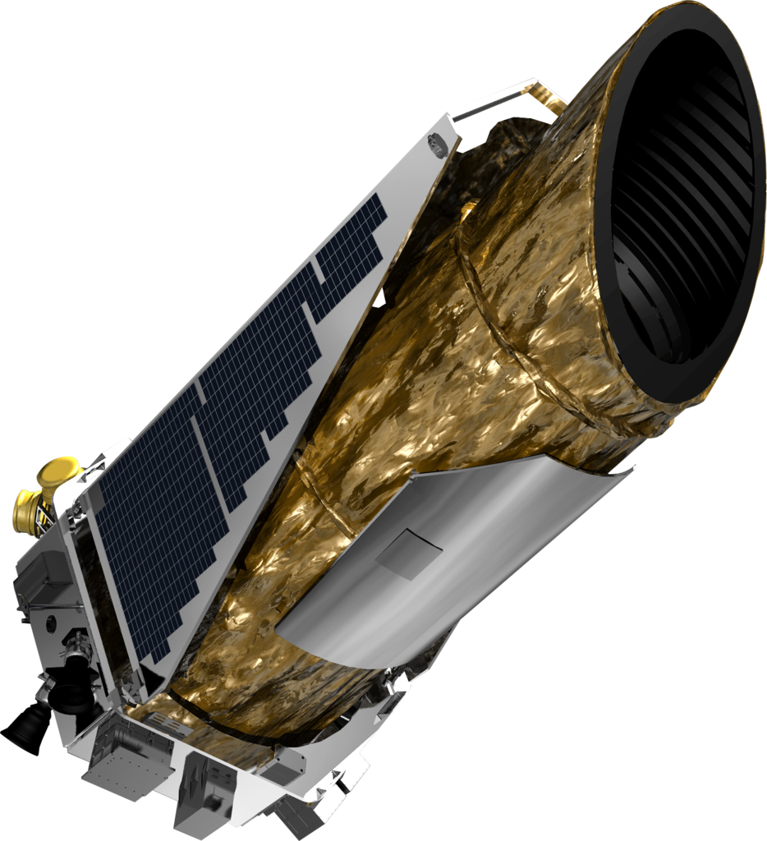
Machine Learning Models used
Support Vector Machine
Random Forest Classifier
K Nearest Neighbors
Logistic Regression
Decision Tree Algorithm
Bernoulli Naive Bayes

Slide 8
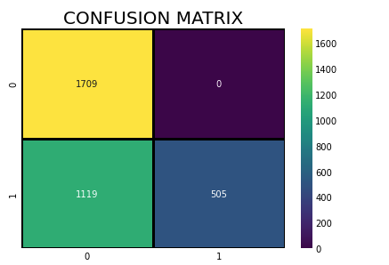
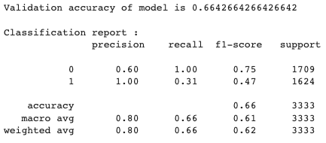
Support Vector Machines

Slide 9
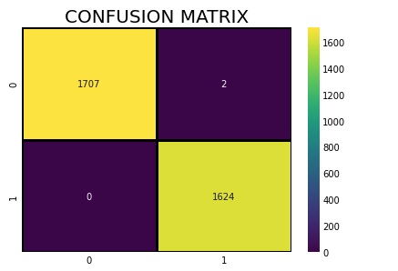
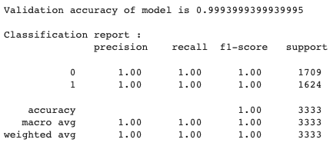
Random Forest Classifier

Slide 10
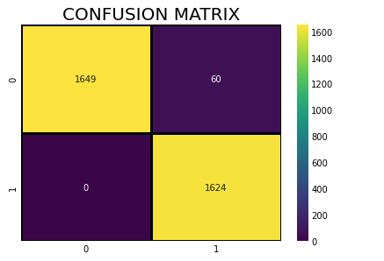
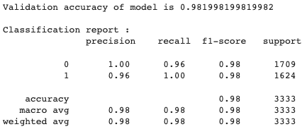
K Nearest Neighbours

Slide 11
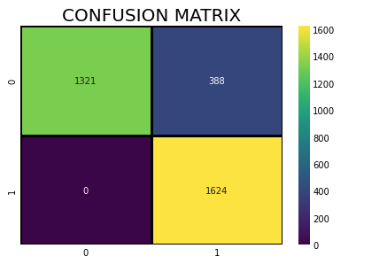
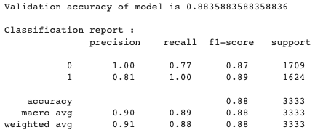
Logistic Regression

Slide 12
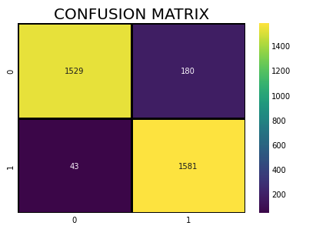
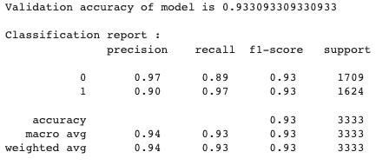
Decision Tree Algorithm

Slide 13
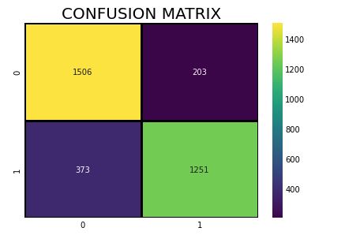
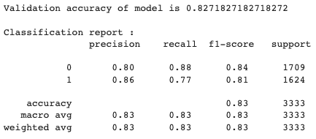
Bernoulli Naive Bayes

Slide 14
Evaluation Results (Accuracy Score)
Support Vector Machine - 0.6642664266426642 i.e. 66.426%
Random Forest Classifier - 0.9993999399939995 i.e. 99.939%
K Nearest Neighbours - 0.981998199819982 i.e. 98.199%
Logistic Regression - 0.8835883588358836 i.e. 88.358%
Decision Tree Algorithm - 0.933093309330933 i.e. 93.309%
Bernoulli Naive Bayes - 0.8271827182718272 i.e. 82.718%
So far we had achieved highest accuracy score of 0.9993999399939995 using Random Forest Classifier. Other models that achieved well were K-Nearest Neighbours and Decision tree algorithm.

Slide 15
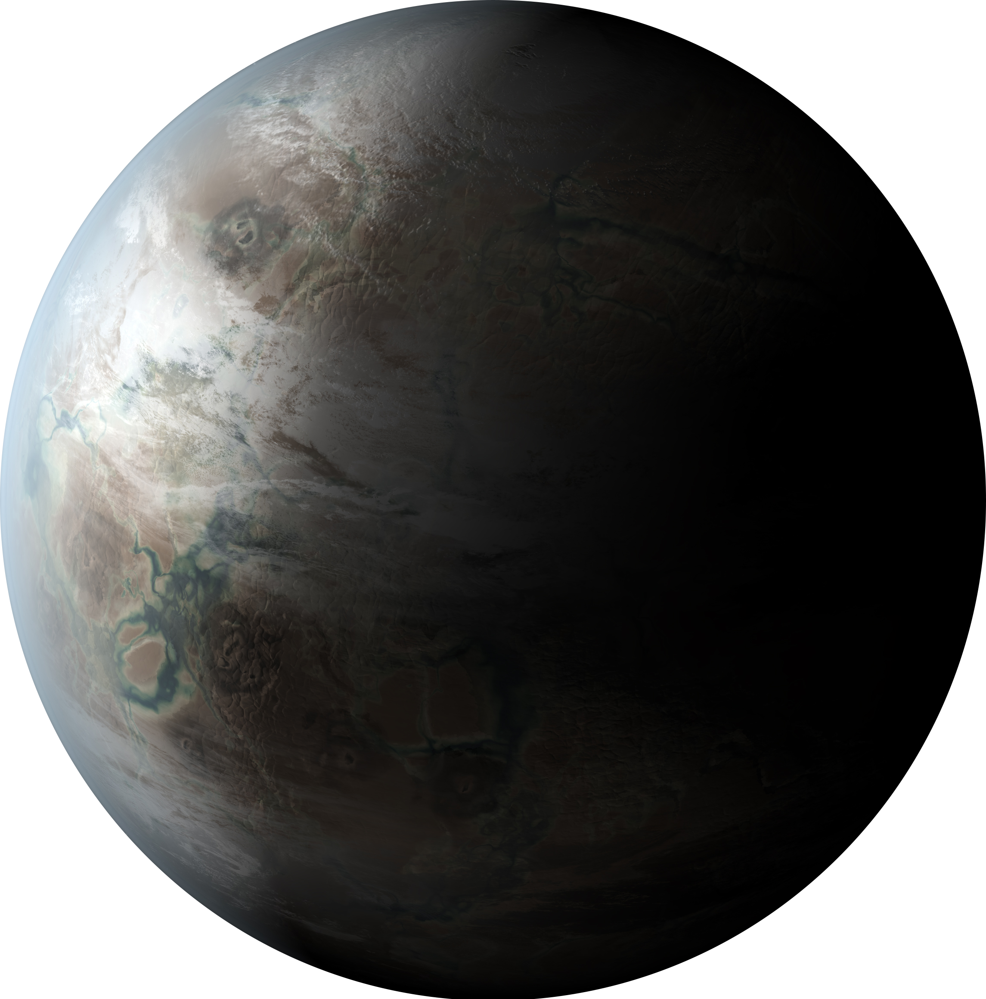
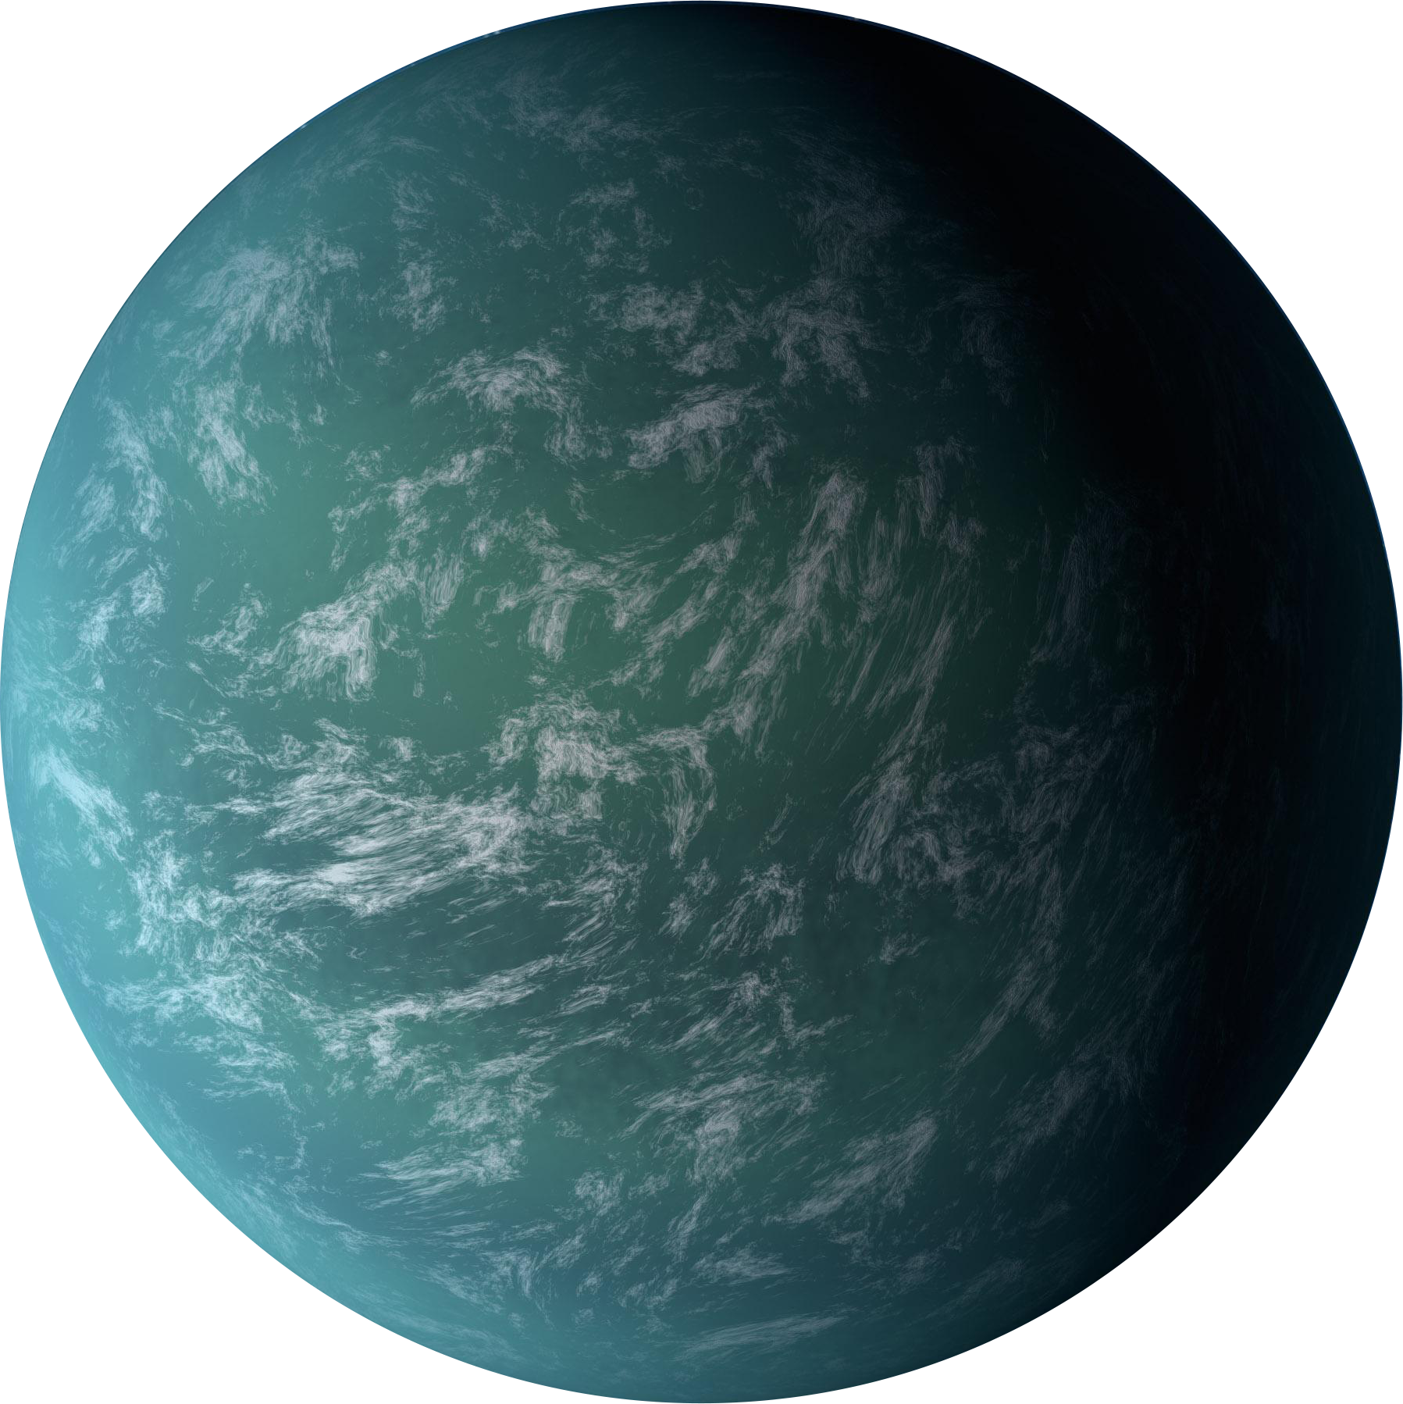
CONCLUSIONS In this project we proposed exoplanet planet detection methods based on classical machine learning. Our method consists of extracting time series features from light curves which are then used as input to our machine learning model.

Slide 16
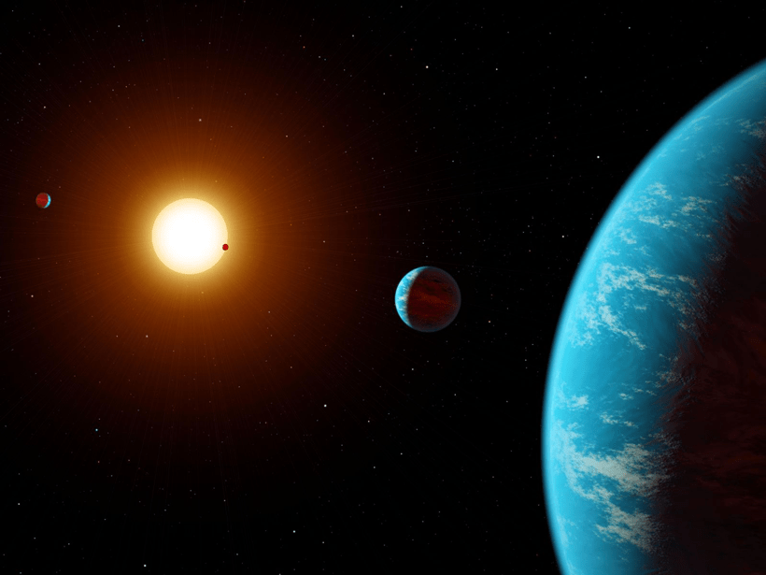
1. Implement various other resampling techniques to address class imbalance problems. 2. Tuning hyperparameters of algorithms to achieve greater accuracy scores. 3. Test the use of Neural Networks to make more accurate predictions. 4. Aim for real-time detection capabilities, for applications where continuous monitoring of stars is possible
FUTURE IMPROVEMENTS

